Slide 1

Housing Prices and Social Venues of Buenos Aires City
Matias Rapagna
June 2020

Slide 2
Identifying the best District to invest in Buenos Aires
When making a decision to purchase a house or apartment in the city, investors would want to:
Choose a district with low property value,
Located in an area of hi social venues density.
Identifying best districts that have this balance saves time and money to every investor

Slide 3
Data Acquisition and cleaning
Geo Referential Data to map districts in Buenos Aires, from a National Government site https://datosgobar.github.io/georef-ar-api/download
Generated an Excel data with the average price per square meter in each of the districts. This was based on information obtained by https://data.buenosaires.gob.ar/, from the City of Buenos Aires government.
Forsquare API to get the most common venues of given each of the districts in Buenos Aires.

Slide 4
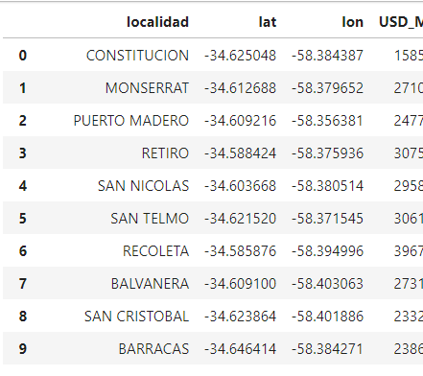
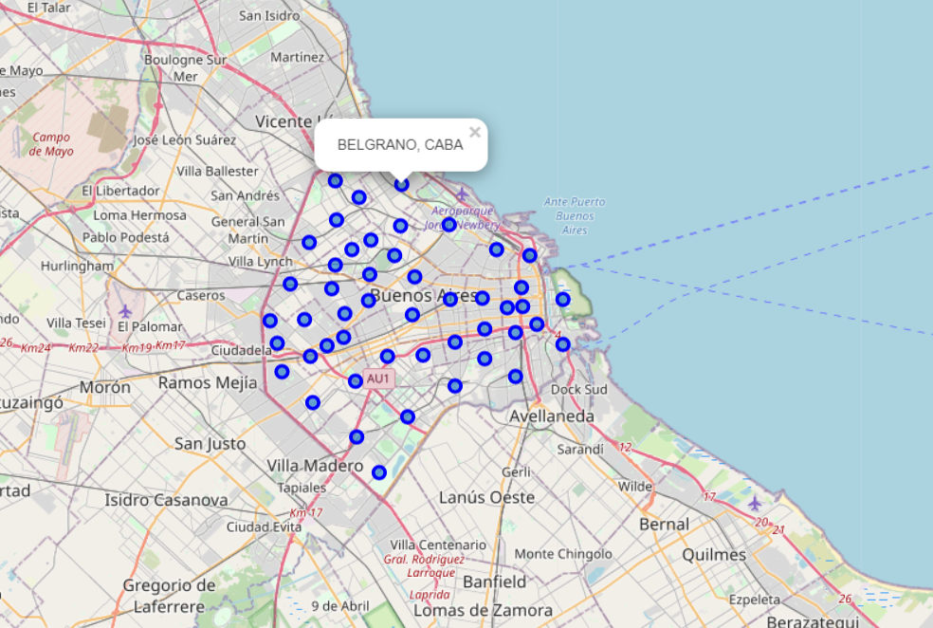
Buenos Aires GeoData
Latitude and Longitude of each of the districts was used to draw Buenos Aires City Map

Slide 5
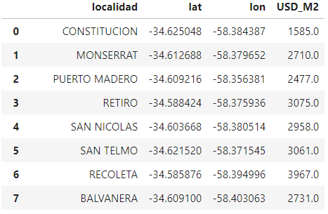
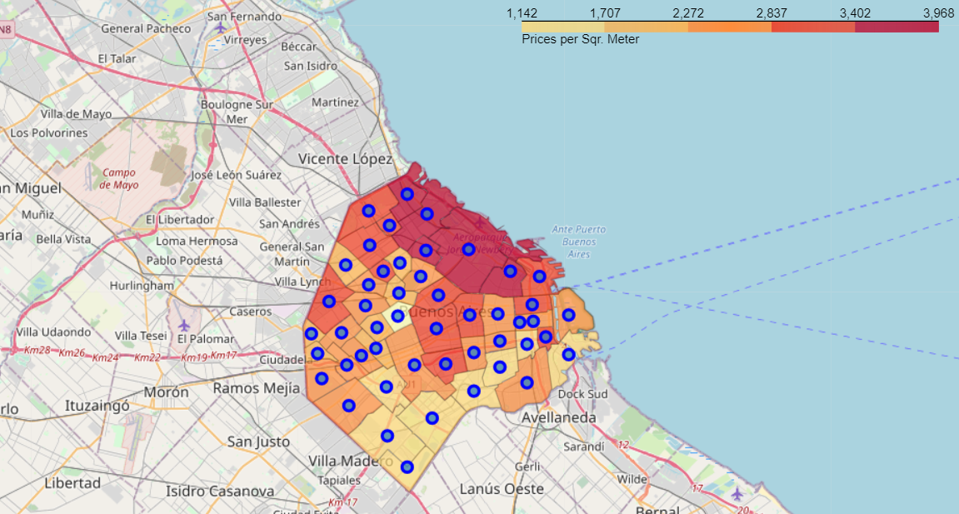
Average m2 price
Average Price per M2 was merged with geo data to be able to draw a Choropleth map

Slide 6
Average m2 price
Average Price per M2 was merged with geo data to be able to draw a Choropleth map

Slide 7
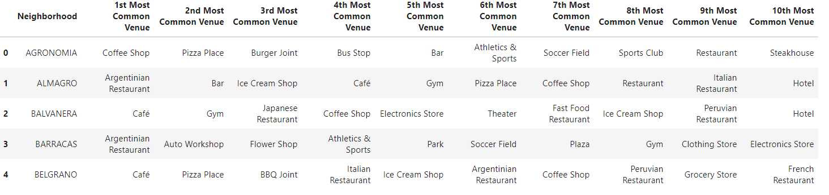

Imported Venues from Foursquare
Data was imported from Foursquare, to merge Price, geo data, and top 10 venues per district.

Slide 8
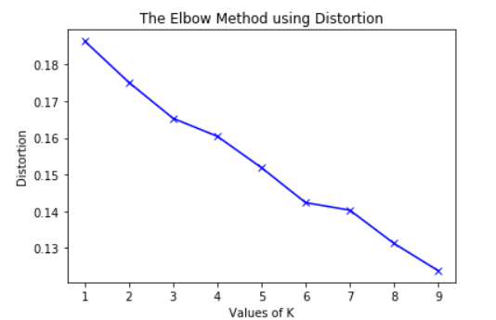
K-means Clustering of districts
We have common venue categories in the districts. In this reason I used unsupervised learning K-means algorithm to cluster the boroughs.
To be able to do so, I needed to select the best K for the K-Means algorithm, so I used the Elbow method.
Unfortunately, there was no significant curve in the graph, so I established 6 as my K for the K-means, as it was the point where the line started to have a less steeper curve.
6

Slide 9
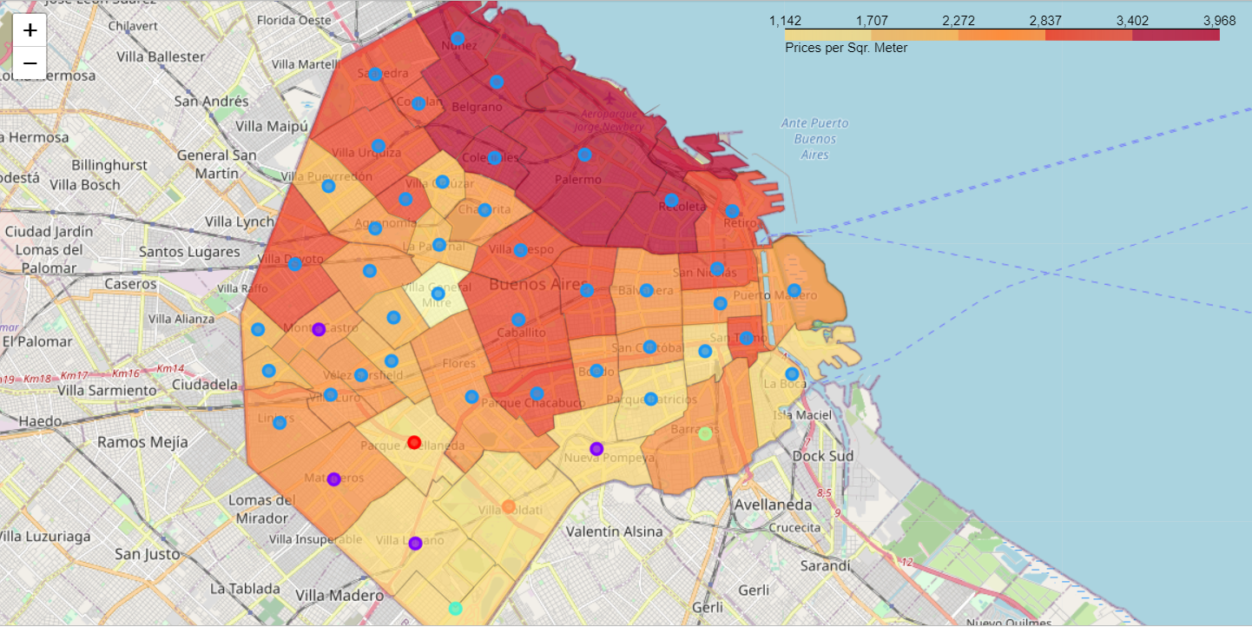
Clustered Districts + Choropleth Price data
I created choropleth map which also has the below informations for each borough:
District Name
Cluster name,
Average Price per m2

Slide 10
Conclusion and future directions
Built useful map to identify best options to invest in Buenos Aires, minimizing price and maximizing social venues nearby.
Accuracy of the implementation has room for improvement.
Ideas include:
Data can be expanded up to Street Level
Exclude not important venues and generate new clusters

